Slide 1

Session 14
Step 3.3 – 3.5
Management Actions,
Compliance, Finance, Finalize EAFm Plan
Essential EAFm training
Date |Place

Slide 2
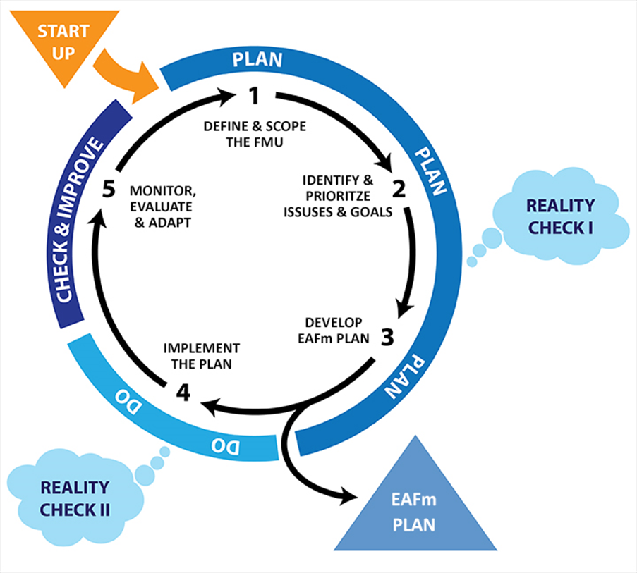
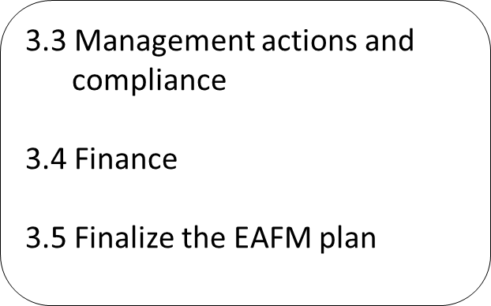

Notes:
We are now at the second part of Step 3 that covers (i) Management actions and compliance, (ii) finance and (iii) finalizing the plan.
Refer to large flipchart of this on wall (laminate) to keep up as reference throughout course. Show where we are in course.

Slide 3
Session Objectives
After this session you will be able to:
Identify management actions and how stakeholders will comply with these
Include financing mechanisms in the plan
Bring it all together – finalize the EAFm plan
Notes:
Self explanatory

Slide 4
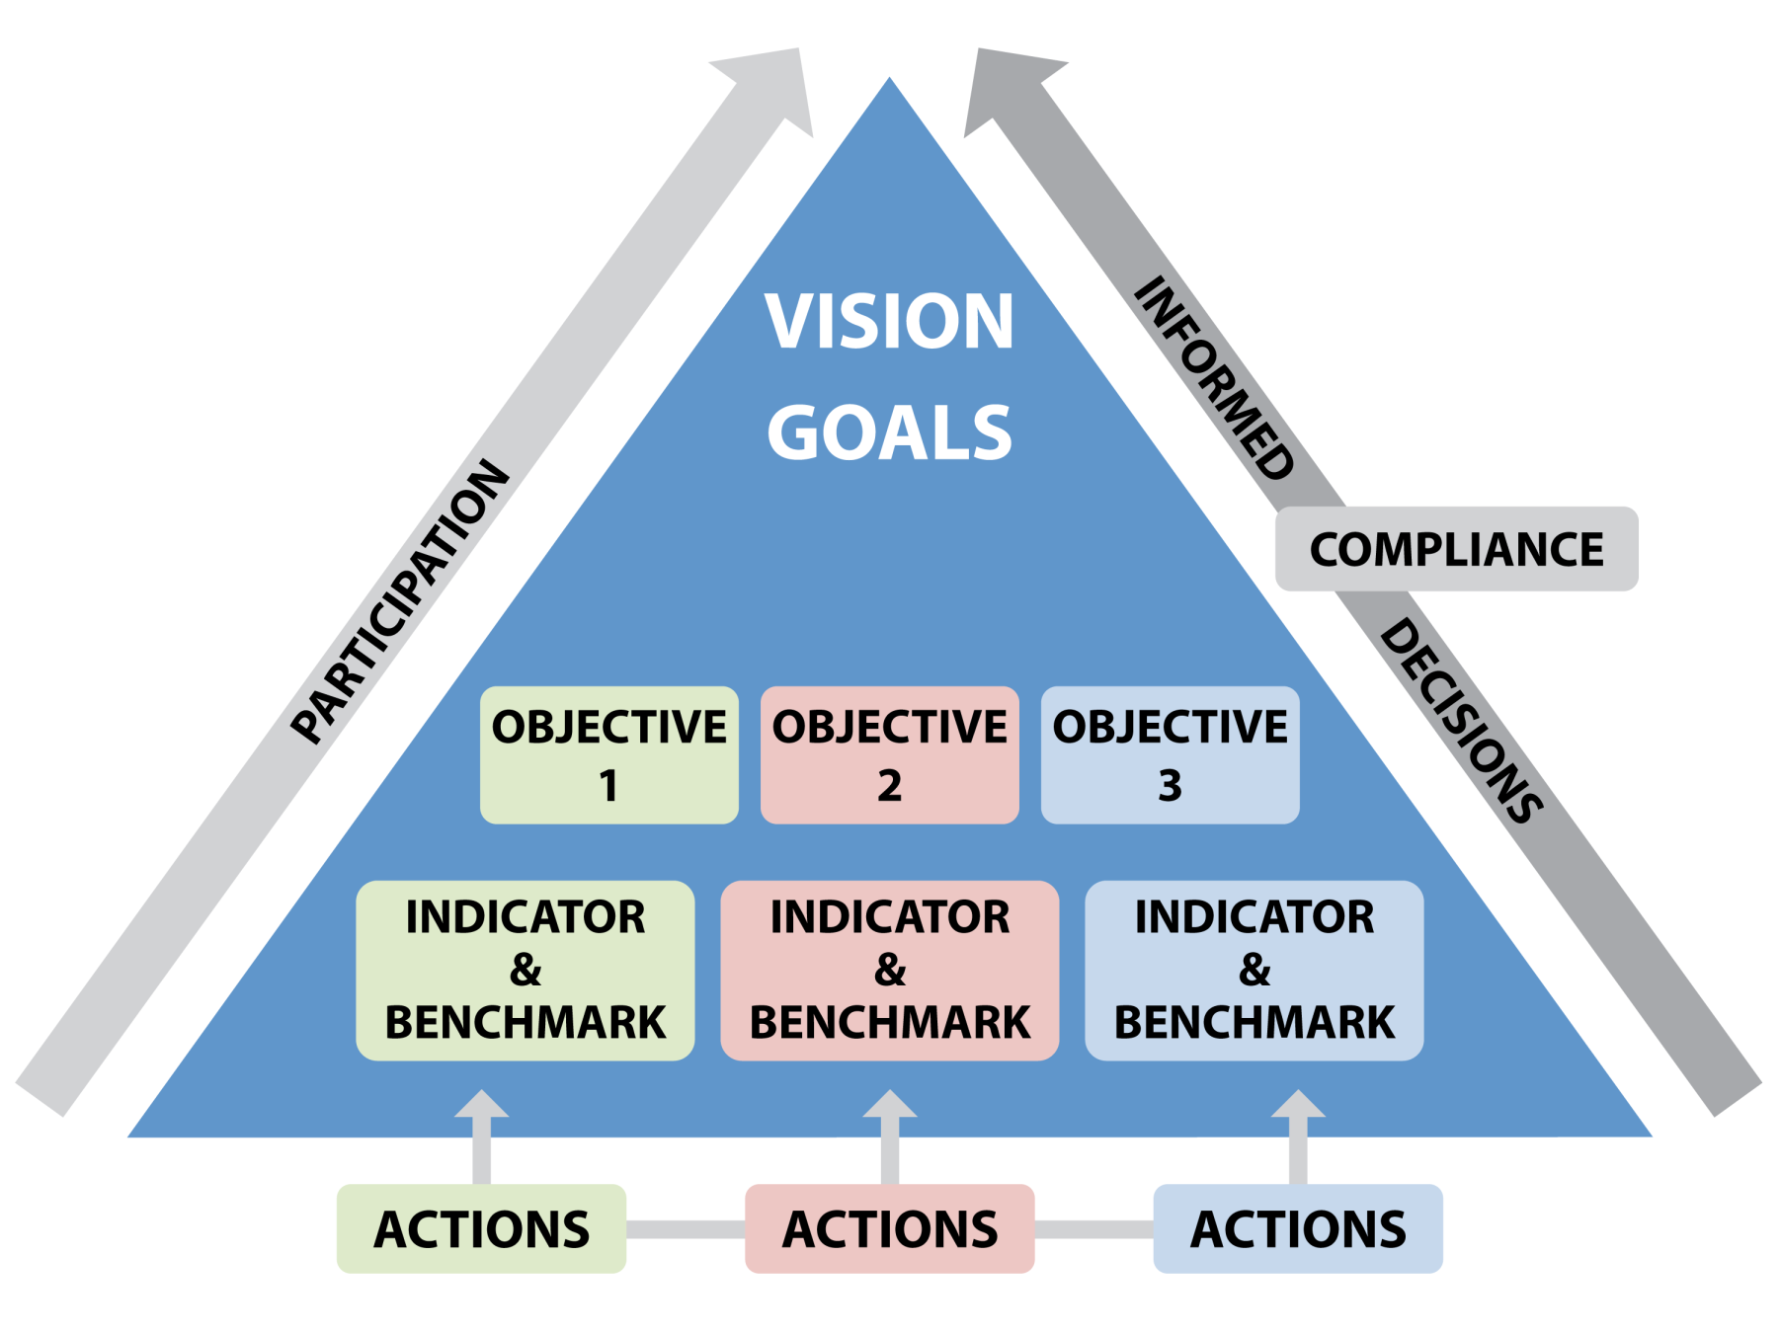
GOAL
FINANCE
Notes:
We are now adding management actions (linked to compliance).

Slide 5
Management Actions
An action that will help meet the objective
Management actions could include:
  Technical measures
    Catch and effort controls (e.g. gear restrictions, limited entry)
    Spatial and temporal controls (e.g. conservation zones, seasonal closures)
  Ecosystem manipulation
    Habitat restorations (e.g. plant riparian habitat, improve connectivity, modify water control structures, improve flows)
  Community-based
    Income diversification (e.g. alternative livelihoods skills)
Notes:
The management actions for EAFm are broad. They include the technical measures that may be familiar to the fishery people, ecosystem manipulations and community-based actions. Continue onto next slide.
Refer to module 14, step 3.3 for more detail as well as Manager’s Toolbox (tool 33) in Technical Toolkit (though this is a marine example). Pick out some examples from Manager’s toolbox to illustrate the above points in more detail. Remind participants that they may be already doing some of these (as we discussed on day 1: how much EAFm are you already doing?).

Slide 6
Management Actions (contd).
Human capacity
  Fishery management skills
Strengthen institutions
  Increase coordination (e.g. co-management BVCs, fisher associations, inter-agency task forces)
Work with others to achieve objectives outside your mandate
  Irrigation, water management, environment agency, pollution control, agriculture, etc.
Notes:
Continuing on with the suite of actions we also cover some governance actions.
Refer to module 14, step 3.3 for more detail as well as Manager’s Toolbox (tool 33) in Technical Toolkit (though this is a marine example). Pick out some examples from Manager’s toolbox to illustrate the above points in more detail. Remind participants that they may be already doing some of these (as we discussed on day 1: how much EAFm are you already doing?).

Slide 7
Grouping Management Actions
The same management action (e.g. no-take conservation zone) may be linked to several objectives
Duplicate management actions can be deleted, as long as the link to the specific management objective is not lost
Notes:
Management actions may serve to meet several objectives (and goals). The same management action (e.g. no-take conservation zone) may be linked to several objectives and have the same indicator and benchmarks (targets/ baseline). Duplicate management actions can be deleted, as long as the link to the specific operational objective is not lost.

Slide 8
VISION
Goal
Goal
Goal
Objective
Objective
Objective
Objective
Indicator
Indicator
Indicator
Indicator
Benchmark
Benchmark
Benchmark
Benchmark
Management action
Management action
Management action
Notes:
This diagram shows that management actions need not be linear with the objective as 1 action might address several objectives e.g. conservation zone for habitats and fish stock rebuilding.

Slide 9
Compliance & Enforcement
When management actions are developed how to ensure they are complied with?
Range of compliance methods available:
  For fisheries we use the term monitoring, control and surveillance (MCS)
    Monitoring - data/information gathering for compliance
    Control - rules/controls applied to the fishery
    Surveillance - patrolling/enforcement
It is important to note, that Fishers Associations and even co-management groups (BVC) can conduct MCS, especially if they are authorized
Notes:
Explain the meaning of MCS – a term used for compliance and enforcement in fisheries. Also stress the need the cooperation needed (between departments/ agencies) for EAFm to work. An example is when rules & regulations are enforced by navy/ police patrols, sometimes judiciary system ineffective so there is no deterrent. This can be improved when stakeholders have buy-in and are motivated, they are more likely to adopt and maintain self-compliance.

Slide 10
Monitoring, Control and Surveillance
MCS needs:
Cooperation and coordination across several agencies, fishers-groups and stakeholder “buy-in”
Training & financial resources
Education and awareness raising
Surveillance
Effective sanctions/penalties
Notes:
Need MCS to enforce the management actions you choose to adopt to reach objectives. EAF net has very little information on this. Refer to Module 14, step 3.3 for more detail. Have examples ready to illustrate. Refer to suggestions for improving MCS (Fiji context) in Tool 34. Stress the need for stakeholder ‘buy-in’ and how this can be fostered thru initial consultation and co-management approach. Also refer to Module 16 Reality Check II for a reminder on compliance.

Slide 11
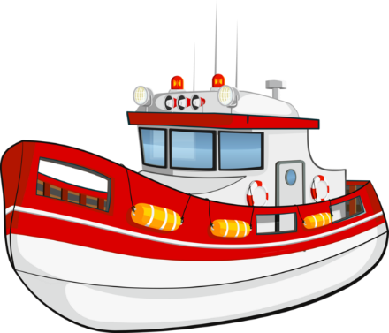
Top–Down
Government MCS:
Fishery enforcement
Limited capacity
Corruption issues?
Notes:
MCS can be top-down e.g. enforced by fishery patrols. Many problems with this type of enforcement.

Slide 12
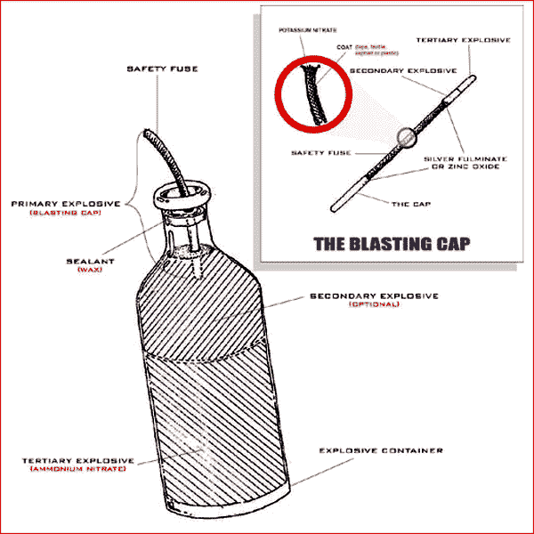
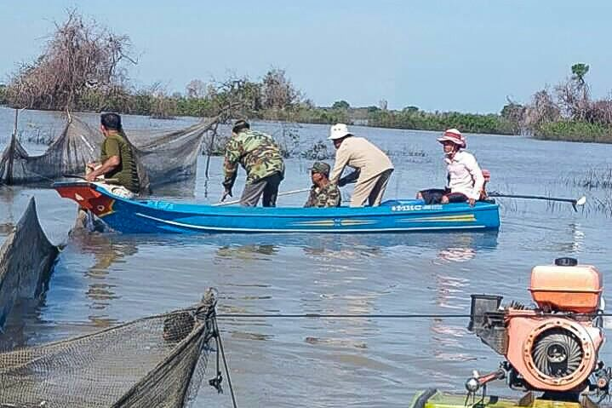
Bottom-Up
Local MCS:
Co-management fish wardens and “eyes on the water” improves compliance.
Builds trust
Encourage stakeholders Acceptance of the rules
Notes:
Bottom-up. Local MCS under a co-management arrangements.

Slide 13
Top-Down vs. Bottom-Up
Often a combination of both is needed
Developing the EAFm Plan with full stakeholder participation increases “buy-in”
Stakeholder “buy-in” reduces the need for enforcement i.e. it generates self-compliance
Need to develop appropriate incentives
Notes:
Often a combination of top-down and bottom-up is needed. Explain how stakeholder “buy-in” reduces the need for enforcement i.e. self-compliance. Developing the EAFm Plan with full stakeholder participation increases “buy-in”.

Slide 14
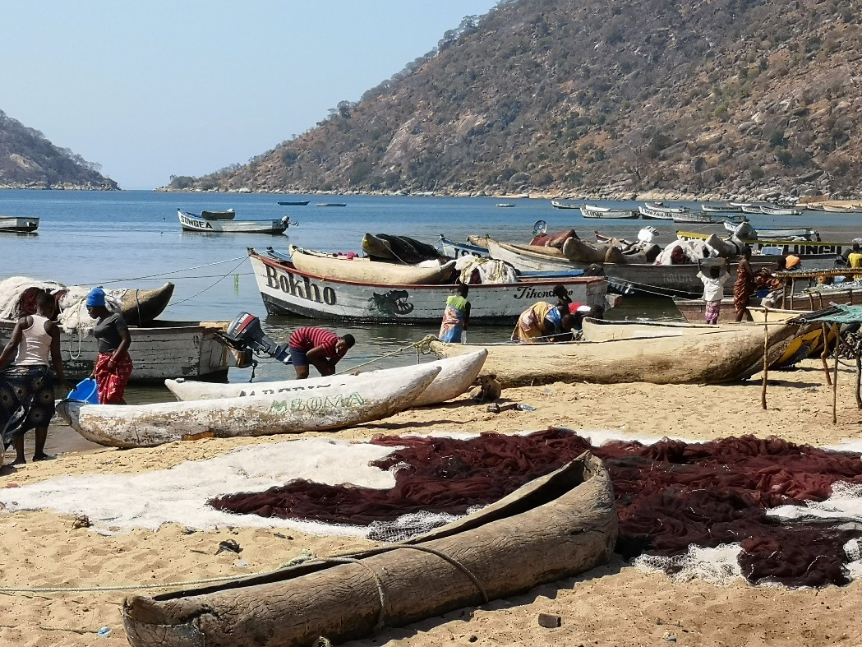
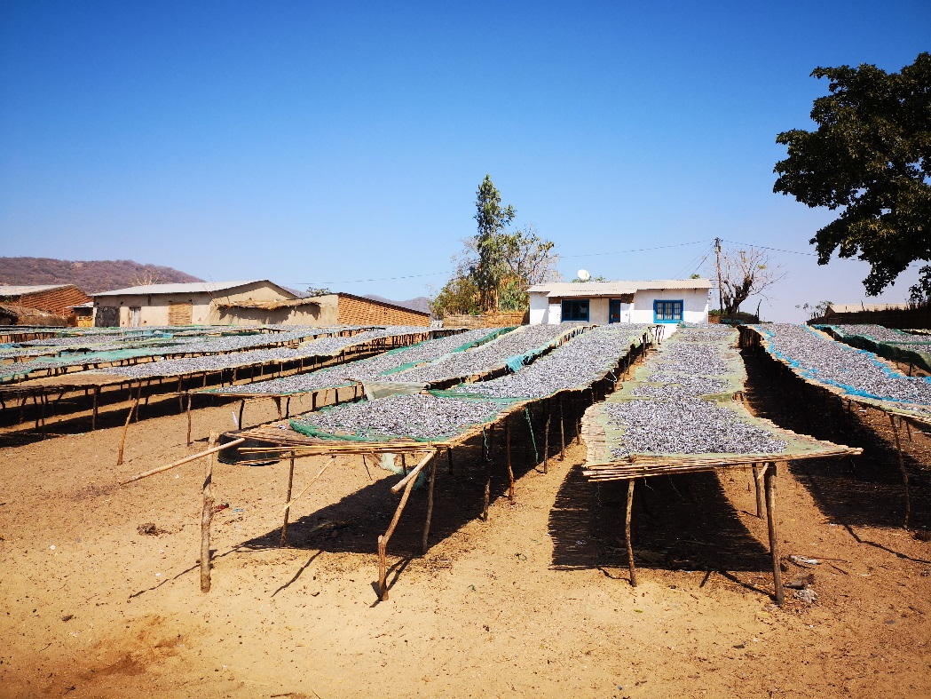
Landing site monitoring: catches/landings & gear
Notes:
Relatively cheap option to ensure compliance and enforcement include port monitoring that can monitor catches/landings and gear.

Slide 15
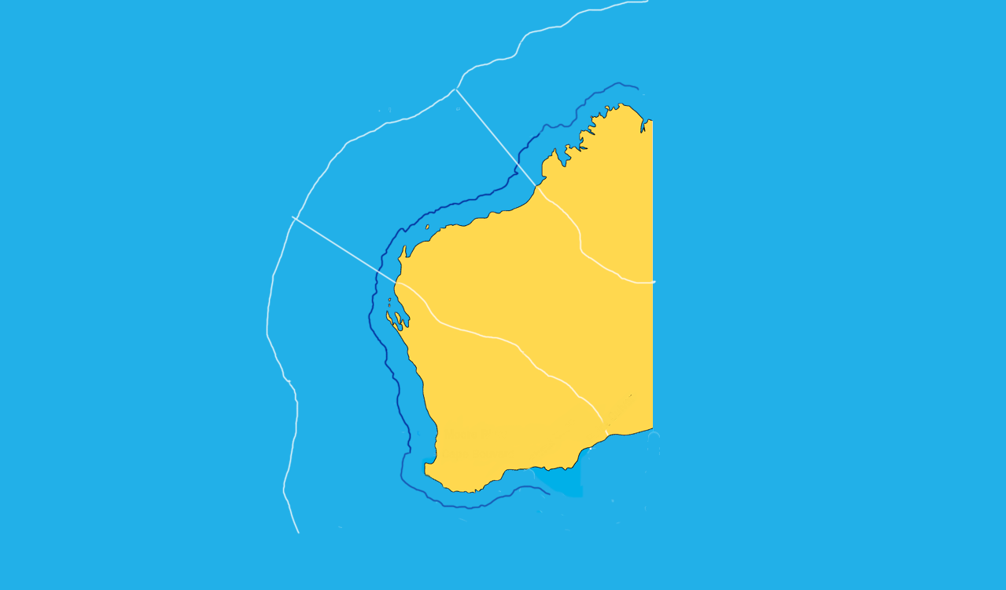
Example of MCS:
Community monitoring of Fishing Zones
Open fishery
200m protected zone
1 km local zone
VMS to track large vessels
GPS for small boats
Community fishery patrols
FCZ wardens
District boundary
Notes:
One common management action in the region is zonation e.g. an artisanal zone and delimited commercial fisheries zone. VMS can be used to track larger vessels (only on very large lakes/seas) and GPS (possible in smaller water bodies now cheaper enough for smaller boats.
Also community level monitoring (linked to GPS) - community fishery patrols may ensure fishers are complying with CF rules and regulations.
In the case of protected or conservation areas/refuges, there may also be specific community patrols.
Linking observation to GPS and camera evidence can be used to build a case, or back up CF sanctions.

Slide 16
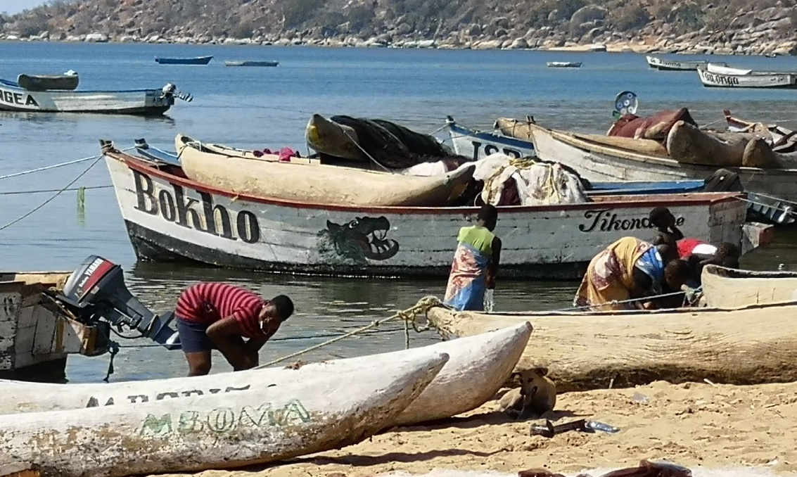
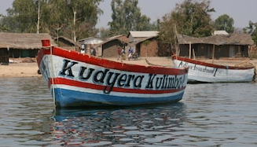
Another Example: boat markings
Notes:
Simple techniques such as wheel-house markings can be effective.
Example: Vessel marking schemes can indicate if a vessel has the right to fish in a particular area.
Colours visible at a distance are easiest method,
Boat markings also indicate the registration and port/home location of the vessel.
Other vessel marking schemes may be used, but may be less visually obvious.

Slide 17
Finishing the EAFm Plan
You have now completed most of the EAFm Plan
Add “Data and information”
Add “Financing”
Notes:
Because we are at the end of the planning process, all that is needed to complete the plan are sections on “Data and information needs” and “Financing.”

Slide 18
3.4 Data and Information Needs
Data and information needs have been discussed previously in steps 1 & 3.
The EAFm plan needs a separate section
  Who is responsible for measuring the indicator(s)?
  Where do the data come from (new or existing)?
  If new, what method will be used?
Notes:
The EAFm plan needs a separate section on data and information. In particular, it needs to specify where the indicator data and information is being collected and/or collated and by whom. Sources of data and information were covered in Module 10 Step 1.3 Scope the FMU and in Module 13 Step 3.2 Indicators. The questions asked in those modules need to be answered here:
Who is responsible for measuring the indicator(s)?
Where do the data come from (new or existing)?
If new, what method will be used?

Slide 19
3.4 Financing
Plan needs to have a section on how it will be financed
Budget
  How much?
  Where from? (Existing? New?)
  Need to consider who will/can pay, equity, impacts
A good EAFm Plan will attract funding from different sources
  Ideally the plan should be supported from existing budget by including it in the budget planning cycle
  Or revenues/landing feeds generated by the fishery
Notes:
No plan is complete without considering how it will be financed. Here are some of the questions that need to be asked.
This list of finance sources is not complete. Can participants think of any others
Refer for more detail to module 14, step 3.4. Have examples ready to illustrate.
How can EAFm cycle take place with limited resources?
What are the likely gaps? What will need prioritising?
Think of human resources and financial resources.

Slide 20
Sources of Funding
Preferably Government (part of the normal budget cycle)
Other sources:
  Government special grant
  Donors (may cover startup costs but not ongoing)
  Grants from NGOs
  Fishing fee (e.g. licenses or fish landing fees)
    Linked to access rights
  Fines for non-compliance
  Stakeholders (share the costs)
Notes:
No plan is complete without considering how it will be financed. Here are some of the questions that need to be asked.
This list of finance sources is not complete. Can participants think of any others
Refer for more detail to module 14, step 3.4. Have examples ready to illustrate.
How can EAFm cycle take place with limited resources?
What are the likely gaps? What will need prioritising?
Think of human resources and financial resources.
Refer participants to Participant Handbook Module 14, Table 14.2 for examples of sources of funding.

Slide 21
3.5 Finalizing the EAFm Plan
You have now completed headings 1 – 9 of the EAFm Plan
The last heading on “Review of the Plan” simply needs a timetable of suggested reviews
We look at this in more detail in Step 5.
Notes:
Although we have not done steps 4 & 5 yet, there needs to be a link to them in the plan. Because we are at the end of the planning process, all that is needed to complete the plan are words such as “The EAFm plan will be communicated to stakeholders and others through a communication plan” and “The EAFm plan will be reviewed annually with a major review every 5 years.
See Module 14, step 3.5. Last 2 headings to be covered in steps 4+5 (though some data and information needs were covered in step 1.3 and 3.2).

Slide 22
The EAFm plan is now complete
EAFm Plan for FMU XX
Vision (Step 1)
Background (Step1)
Major threats and issues (Step 2)
Goals (Step 2)
Objectives, indicators and benchmarks (Step 3)
Management actions (Step 3)
Compliance (Step 3)
Data and info needs – source of data, etc. (Step 3)
Financing (Step 3)
Review of the plan – timetable for review
Notes:
We have now all the information we need for the EAFm plan.

Slide 23
Key Messages
In Step 3.3 – 3.5:
Management actions are decided for each objective
  Compliance with the management actions is also considered
Duplicate actions are removed
  One management action can often address several objectives
  The outputs from steps 1,2 and 3 are used to create the EAFm plan
  Include references to communication and review
Notes:
Self explanatory

Slide 24
In your groups
Produce a set of management actions for the objectives you identified earlier
For each action, consider appropriate compliance and enforcement actions, taking practicalities and costs into account
Agree on financing mechanisms to support the management
Output: Next slide
Notes:
See details in Session Plan. Now groups DO steps 3.3 and 3.4
They take the 4 objectives identified in session before break (2 ecological (1 fish & 1 environmental); (1 human & 1 governance), covering each of 3 EAFm components for their FMU and they need to agree some management actions for these. Use tool 33 Manager’s Toolbox in Technical Toolkit to get ideas. Participants need to work out what compliance/enforcement is needed, and how all this will be financed.
Participants work in their FMU groups; then walk around and see each other’s outputs- trainer guides plenary with key ideas/suggestions.

Slide 25
VISION
Goal
Goal
Goal
Objective
Objective
Objective
Objective
Indicator
Indicator
Indicator
Indicator
Benchmark
Benchmark
Benchmark
Benchmark
Management action
Management action
Management action
Compliance
Finance
Notes:
Now groups DO steps 3.3 and 3.4
They take the 4 objectives identified in session before break (2 ecological (1 fish & 1 environmental)); (1 human & 1 governance), covering each of 3 EAFm components for their FMU and they need to agree some management actions for these. Use tool 33 Manager’s Toolbox in Technical Toolkit to get ideas. Participants need to work out what compliance/enforcement is needed, and how all this will be financed.

